Slide 1
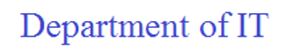

ONLINE PHISHING URL DETECTION USING MACHINE LEARNING TECHNIQUES AND FLASK FRAMEWORK

Slide 2
BATCH – 13 1. Poojitha Kavuri (20NN1A1225) 2. Deekshitha Jonnakuti (20NN1A1220) 3. Sakala Ramyasri (20NN1A1255) 4. Shaik Apsana (20NN1A1256) GUIDE Mrs. P. Sandhya Krishna

Slide 3
CONTENTS
ABSTRACT
INTRODUCTION
LITERATURE SURVEY
EXISTING SYSTEM
DRAWBACKS OF EXISTING MODEL
REQUIREMENT SPECIFICATION
PROPOSED SYSTEM
DESIGNING
EXECUTION

Slide 4
ABSTRACT
Phishing websites have proven to be a major security concern. The ways to recognize various network threats, specifically attacks not seen before, is a primary issue that needs to be looked into immediately. The aim of phishing site URLs is to collect the private information like user’s identity, passwords and online money related exchanges. Phishers use the sites which are visibly and semantically like those of authentic websites. Since the majority of the clients go online to get to the administrations given by the government and money related organizations, there has been a vital increment in phishing threats and attacks since some years. The machine learning approaches to detect phishing websites have been proposed earlier and have been implemented. The central aim of this project is to implement the system with high efficiency, accuracy and cost effectively. That is been achieved. The project is implemented using 10 machine learning supervised classification models. Some of them are K-Nearest Neighbor, Support vector machine, decision tree and random forest classifier. It was established that the Gradient boost classifier provides best accuracy for the selected dataset and gives an accuracy score of 99.2%

Slide 5
INTRODUCTION
WHAT IS PHISHING?
Phishing is a form of fraud in which the attacker tries to learn sensitive information such as login credentials or account information by sending as a reputable entity or person in email or other communication channels.
Typically a victim receives a message that appears to have been sent by a known contact or organization. The message contains malicious software targeting the user's computer or has links to direct victims to malicious websites in order to trick them into divulging personal and financial information, such as passwords, account IDs or credit card details.
Phishing is popular among attackers, since it is easier to trick someone into clicking a malicious link which seems legitimate than trying to break through a computer's defense systems. The malicious links within the body of the message are designed to make it appear that they go to the spoofed organization using that organization's logos and other legitimate contents.URL is the first thing to analyse a website to decide whether it is a phishing or not. As we mentioned before, URLs of phishing domains have some distinctive points. Features which are related to these points are obtained when the URL is processed.

Slide 6
INTRODUCTION
DETECTION PROCESS:
Detecting Phishing Domains is a classification problem, so it means we need labeled data which has samples as phish domains and legitimate domains in the training phase. The dataset which will be used in the training phase is a very important point to build successful detection mechanism. We have to use samples whose classes are precisely known. So, it means, the samples which are labeled as phishing must be absolutely detected as phishing. Like wise the samples which are labeled as legitimate must be absolutely detected as legitimate. Otherwise, the system will not work correctly if we use samples that we are not sure about.
DETECTION:
For this purpose, some public datasets are created for phishing. Some of the well-known one is PhishTank. These data sources are used commonly in academic studies.

Slide 7
LITERATURE SURVEY
S. No | Authors and Year | Description Of Paper | Advantages | Limitations
1 | Tsehay Admassu Assegie. (2021) | The proposed model detects phishing attack through URL classification. The performance of the proposed model is tested empirically and result is analyzed. Experimental result on test set reveals that the model is efficient on phishing attack detection. | The KNN algorithm is used in order to detect the phishing websites. And it gives an accuracy of 85%. | KNN algorithm leads to overfitting as the training data is too small. And the accuracy is low in detecting phishing websites.
2 | Mahajan Mayuri Vilas, Kakade Prachi G, Sawant Purva Jaypralash, Pawar Shila. (2019) | In this project, by using Extreme learning machine phishing websites are founded. When the individual visit any website the features are extracted via its URL. The result which is obtained by extracting the features will act as test data. The objective of this technique is to detect fake or illegal websites and notify the user in advance to prevent users from getting their private information to be misused. | This technique is to detect fake or illegal websites and notify the user in advance to prevent users from getting their private information to be misused. This Experiment is being working great accuracy. | The limitation of this project is that it may prone to bias when increasing the multiple training sets.

Slide 8
LITERATURE SURVEY
3 | Rishikesh Mahajan, Irfan Siddavatam. (2018) | This paper deals with machine learning technology for detection of phishing URLs by extracting and analyzing various features of legitimate and phishing URLs. Decision Tree, random forest and Support vector machine algorithms are used to detect phishing websites. Aim of the paper is to detect phishing URLs as well as narrow down to best machine learning algorithm by comparing accuracy rate, false positive and false negative rate of each algorithm. | Random forest algorithm gives better detection accuracy with lowest false negative rate than decision tree and support vector machine algorithms. | decision tree and support vector machine algorithms gives lower accuracy with high false negative rate.
4 | Atharva Deshpande, Omkar pedamkar, Nachiket Chaudhary, Dr. Swapna Borde. (2021) | This paper surveys the features used for detection and detection techniques using machine learning. Here, they explain phishing domain characteristics, the features that distinguish them from legitimate domains, why it is important to detect these domains, and how they can be detected using machine learning and natural language processing techniques. | Random forest is selected based on it’s performance and built a Chrome extension for detecting phishing web pages. | This project is not a scalable for web service as it does not support online learning. The chances of getting attacked by the phishers is high.

Slide 9
EXISTING SYSTEM
An approach of phishing detection system to detect blacklisted URL also known as phishing websites, so that individual can be alerted while browsing or accessing a particular website. Therefore, it can be utilized for identification and authentication and become a legitimate tool to prevent an individual from getting tricked. The system fosters many features in comparison of other software. Its unique features such as capturing blacklisted URL’s from the browser directly to verify the validity of the website, notifying user on blacklisted websites while they are trying to access through popup, and also notifying through email. This system will assist user to be alert when they are trying to access a blacklisted website.

Slide 10
DRAWBACKS OF EXISTING SYSTEM
As a list of blacklisted URLs is being used to detect the accuracy of predicting the correct results may be very low. There isn’t any standard list of URLs published by any standard organization.
As a part of daily life, We may encounter many new URL’s which seems to be same as original ones and not present in the list. It is hard to differentiate such URL’s.

Slide 11
REQUIREMENT SPECIFICATION
Technologies Used:
Machine Learning
Flask
Software Requirements:
OS: Windows 11
Languages: Python
VSCode
Hardware Requirements:
System: Intel Core i5 2.42 GHz
RAM: 4GB

Slide 12
PROPOSED SYSTEM
As part of our project, we are implementing a new framework to detect these phished websites using Machine Learning Algorithms. As we aren’t using any list of URLs, this can be used to detect any new URL that the user encounters. We use URL features as parameters to the model. There are 7 features that are being considered as major decision parameters among 29 URL features. Using these 7 features an ML model is made to meet the challenges in existing system.
To implement the following proposed system, we have used Gradient boost classification algorithm to classify the given features and predict the phishing percentage of the URL that is provided as the input.

Slide 13
GRADIENT BOOST CLASSIFIER
Gradient Boosting Classifier is a machine learning algorithm that belongs to the class of ensemble methods. It is used for classification tasks and works by combining multiple weak classifiers into a strong classifier. This algorithm works by iteratively adding new decision trees to the model, where each new tree tries to correct the errors of the previous tree. The algorithm starts by training an initial weak classifier on the data. Then, it calculates the residuals (difference between the predicted and actual values) of the weak classifier and fits a new weak classifier on the residuals. The process is repeated for a specified number of iterations or until the residuals are small enough.

Slide 14
ALGORITHM
Input: Training data in the form of URLs. Output: Phishing or Legitimate. Step 1: Collected the dataset which contains the information about both phishing and legitimate websites along with extracted features. Step 2: The data is analyzed and preprocessed. Step 3: Features are selected from the dataset based on correlation and are used for training and testing the model. Step 4: Training the classifier using the training data and produces a forecast result from each decision of the sample. Step 5: Make predictions using the testing data. Step 6: Evaluated the accuracy and other metrics for the predicted model.

Slide 15
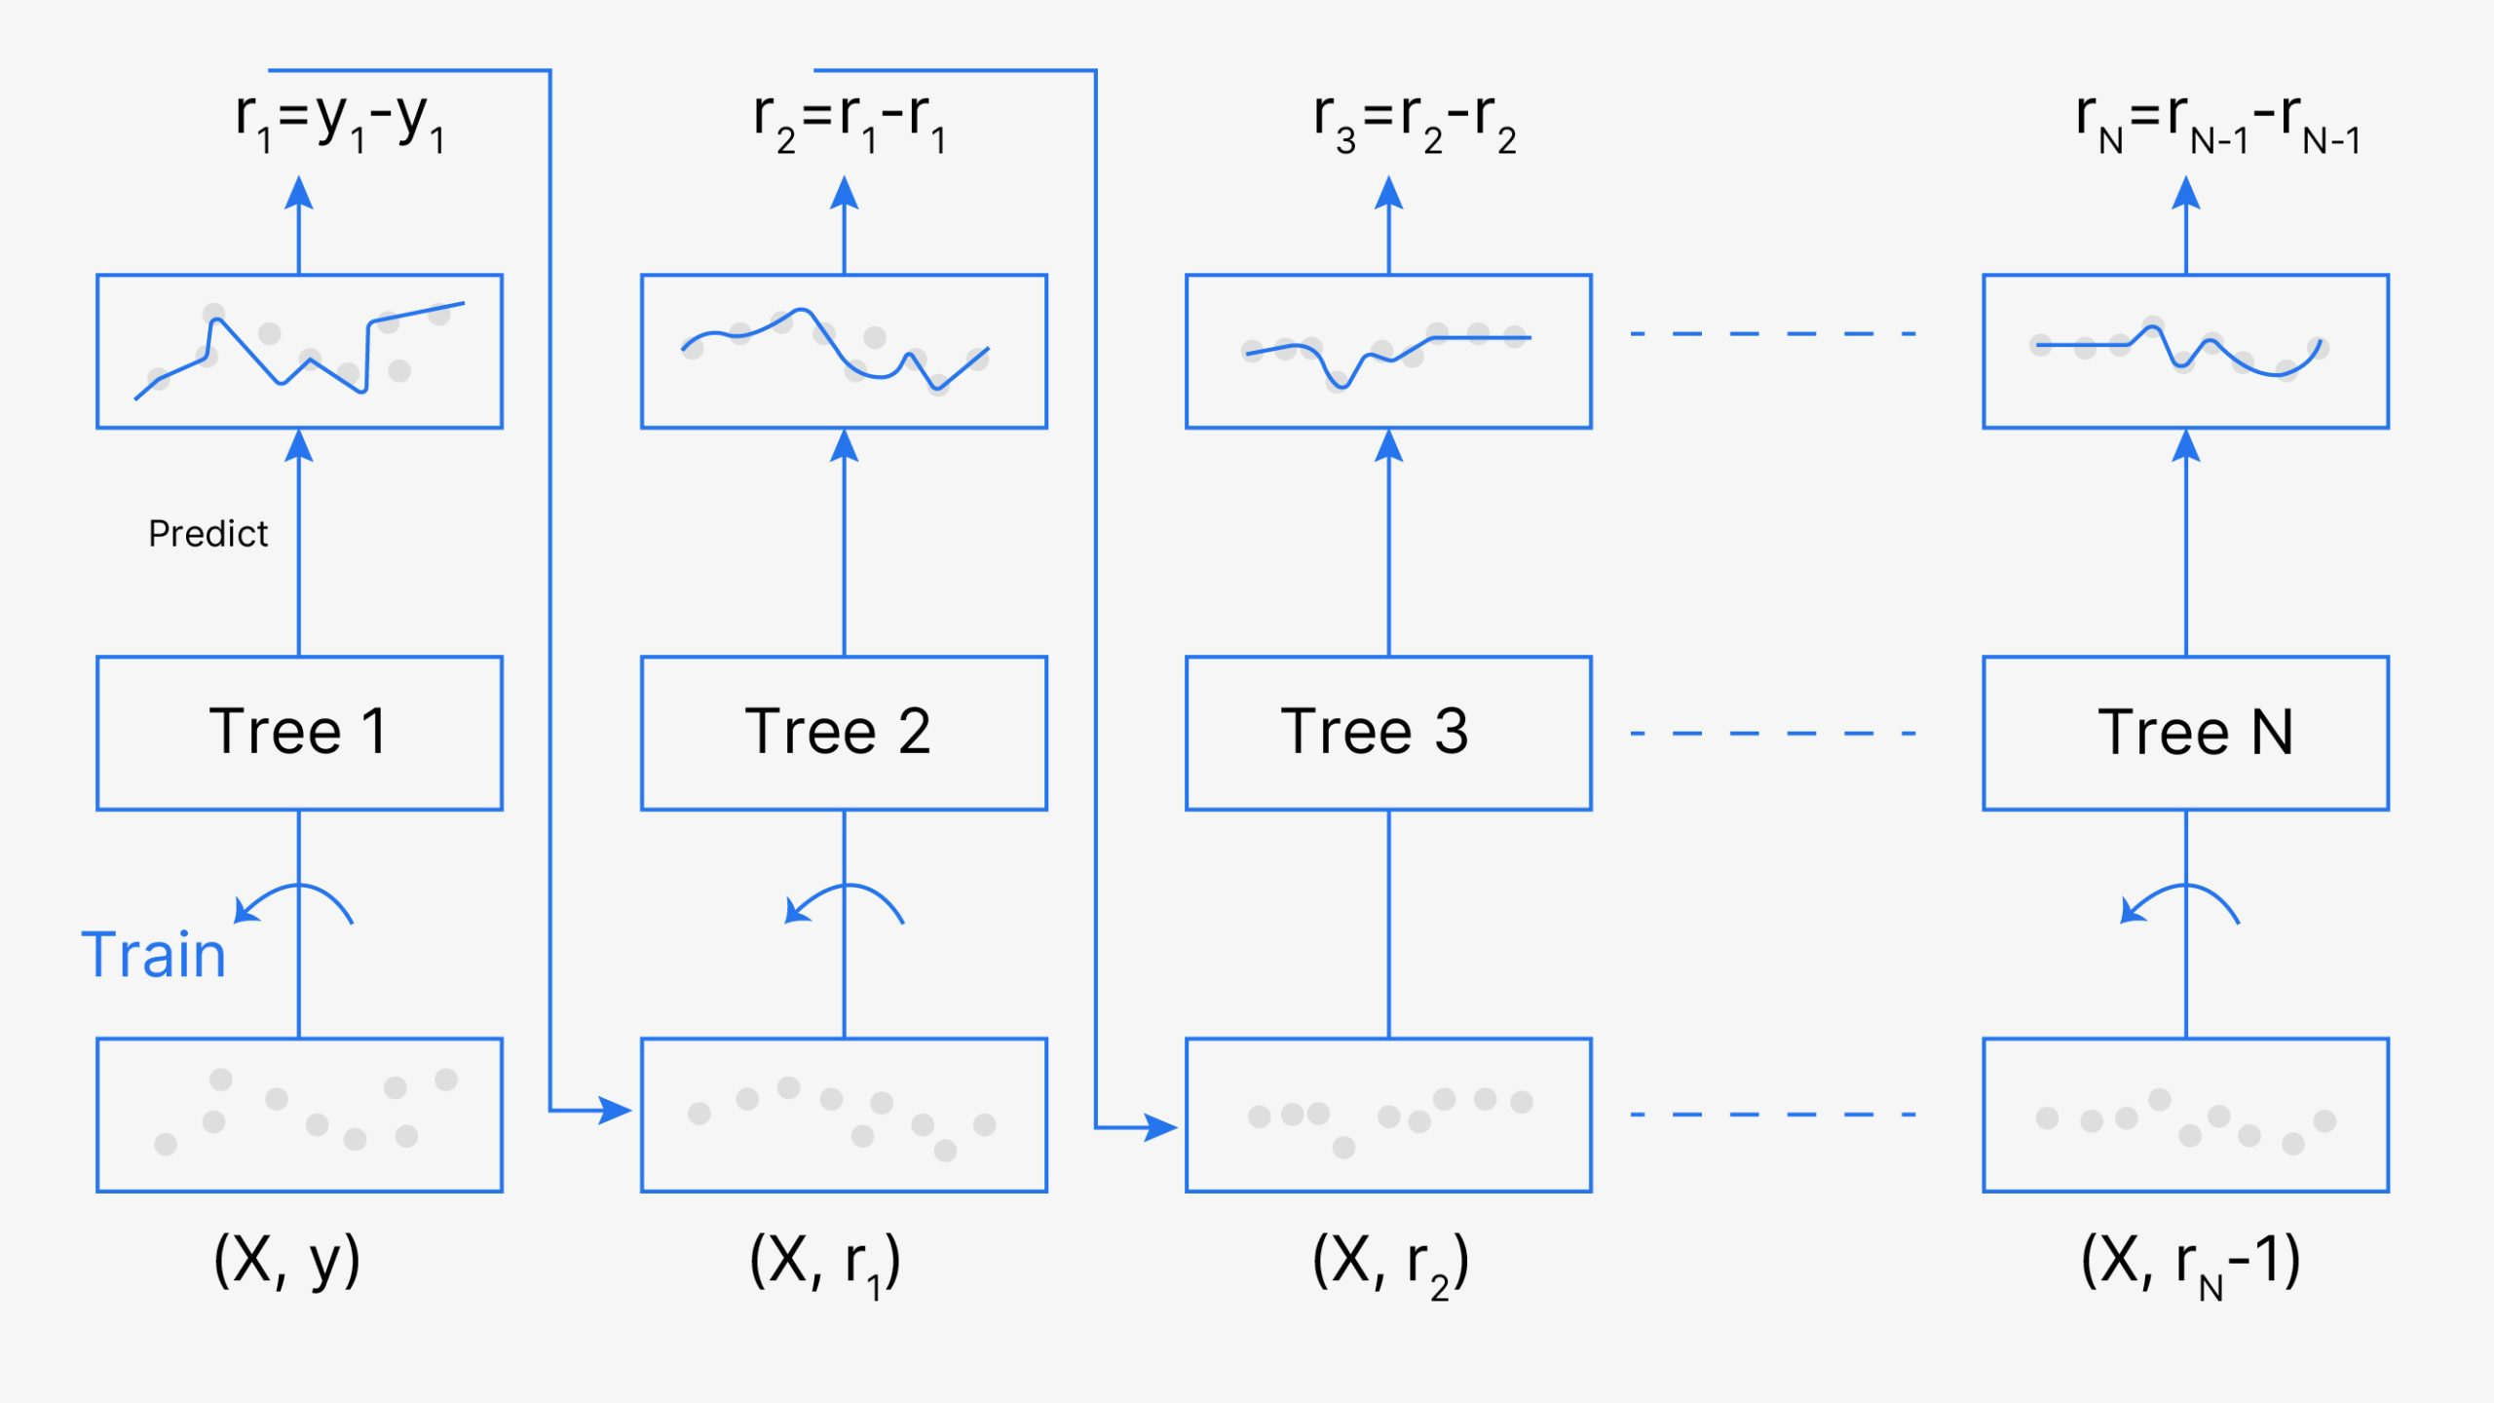
GRADIENT BOOST CLASSIFIER

Slide 16
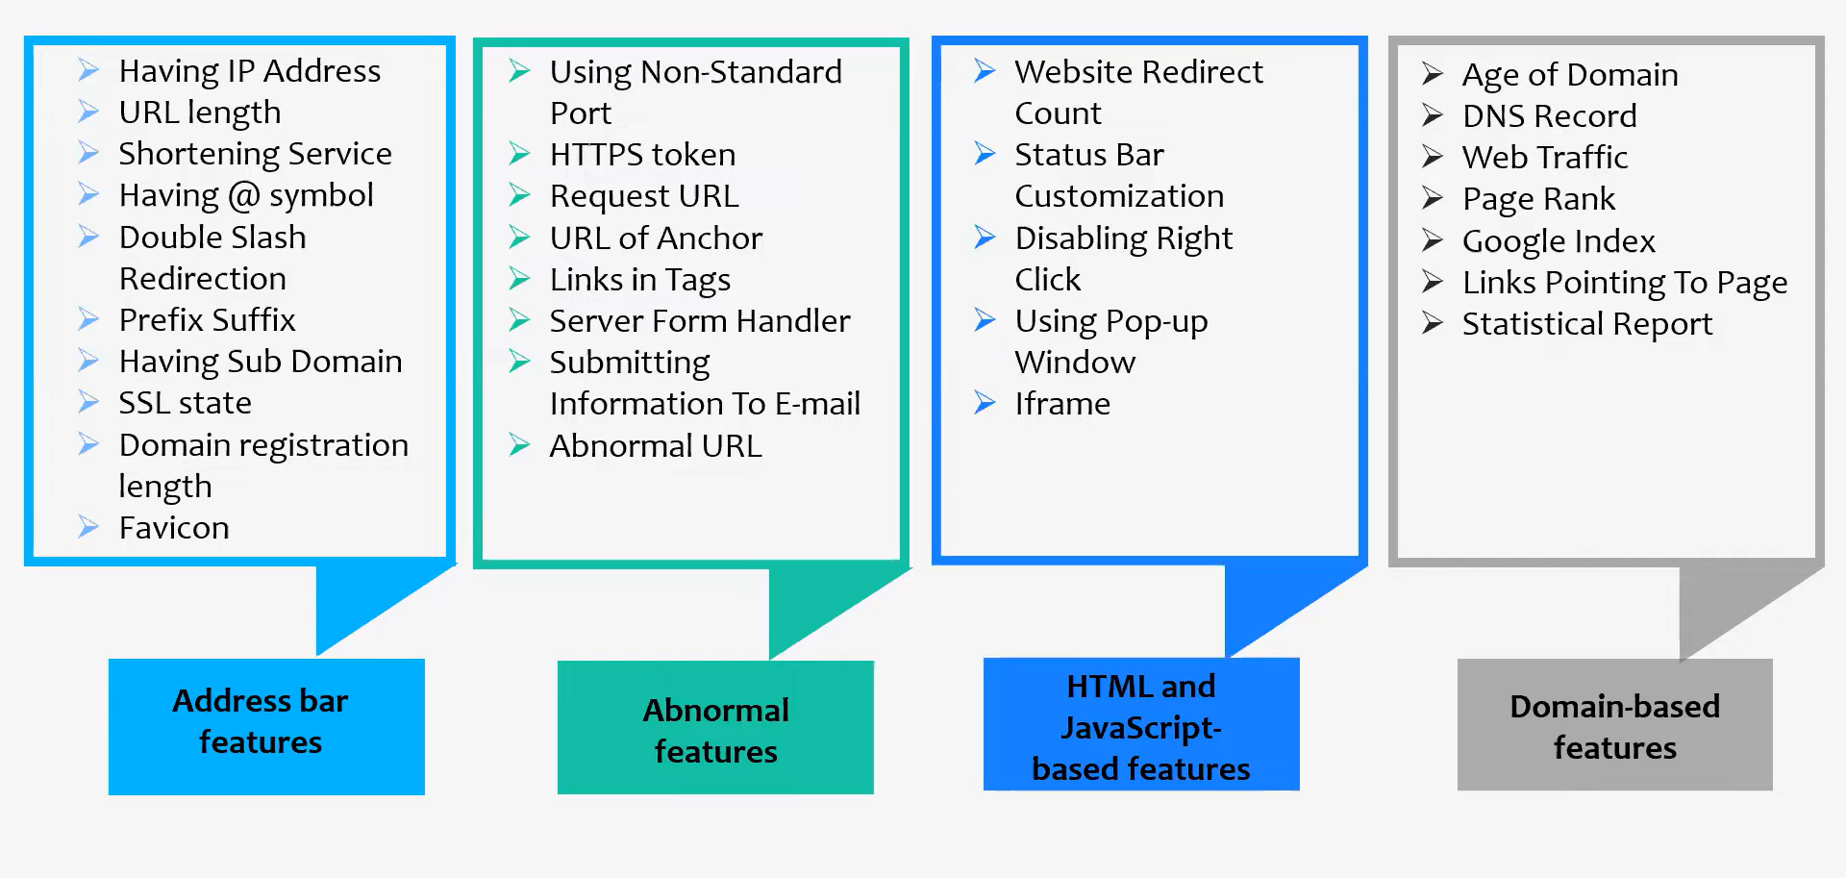
DATASET DESCRIPTION

Slide 17
ADVANTAGES OF PROPOSED SYSTEM
It is known for its prediction speed and accuracy
Works well with large and complex datasets
Combines multiple weak classifiers into a strong classifier
It works by iteratively adding new decision trees to the model, where each new tree tries to correct the errors of the previous tree.

Slide 18
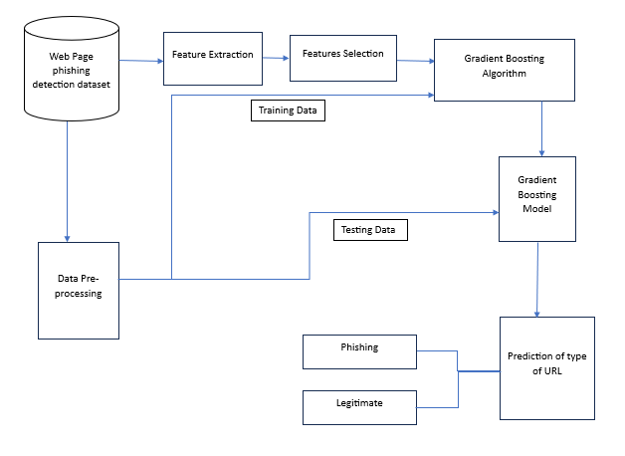
DESIGNING

Slide 19
DESIGNING
Initially we have acquired a dataset from Kaggle website which contains 11430 URLs of both phishing and legitimate and various features under the following categories: Hyper link-based features, content-based features and some features are extracted from querying external services. This dataset is collected in its raw form, but it has been preprocessed to increase its dependability and usefulness for machine learning algorithms. Data cleaning is done to get rid of unnecessary information, values that are missing and invalid, and data that the ML algorithms would find difficult to process. In the next step we have selected some important features by using Correlation based feature selection. Later ML model is created by utilizing extensible algorithm. The result of the model would be a forecast as to whether the attributes of the given data could indicate a legitimate website or a fraudulent website. Here Gradient Boosting algorithm is used in order to build the model.

Slide 20
FEATURE SELECTION
Performance is greatly influenced by the characteristics of the data that are trained into ML models. Model performance may be negatively impacted by irrelevant features or partially relevant. For feature selection, we employ a correlation-based feature selection approach. Correlation-based feature selection selects features that have low linear relations with other features, but are correlated with the label.
In dataset we have a total of 87 Extracted features from the URL. From them we have selected the most important 23 features using correlation-based feature selection method. The following are the features that are selected from CBFS method.

Slide 21
FEATURE SELECTION
length_url shortest_word_host
longest_words_raw longest_word_path
phish_hints nb_hyperlinks
ratio_intHyperlinks length_hostname,
tld_in_subdomain domain_age
prefix_suffix page_rank
ratio_intHyperlinks domain_in_title
empty_title google_index
ip nb_dots
nb_qm nb_eq
nb_www nb_slash
ratio_digits_url ratio_digits_host

Slide 22
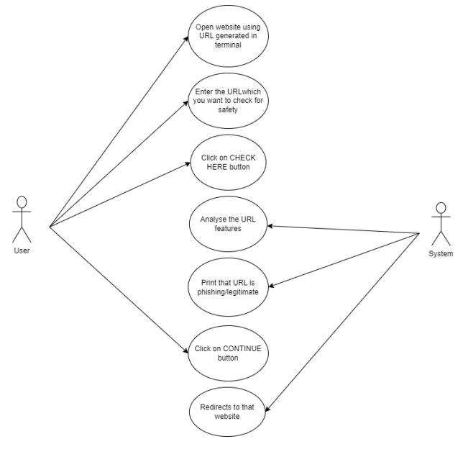
USECASE DIAGRAM

Slide 23
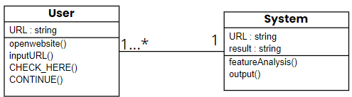
CLASS DIAGRAM

Slide 24
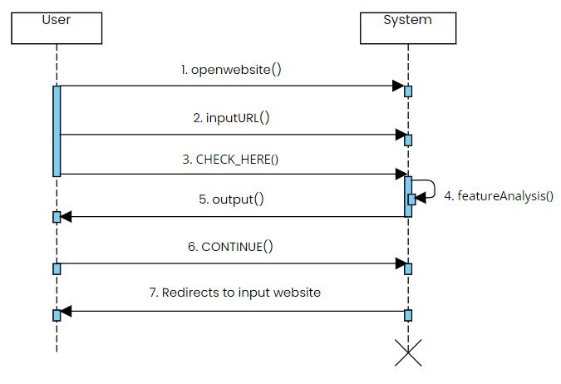
SEQUENCE DIAGRAM

Slide 25
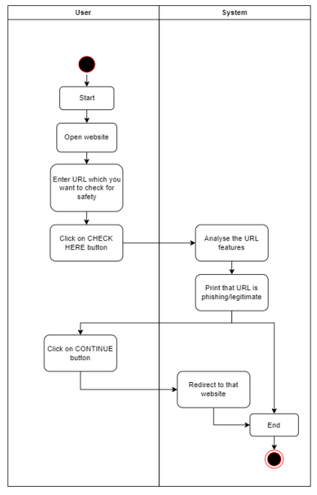
ACTIVITY DIAGRAM

Slide 26
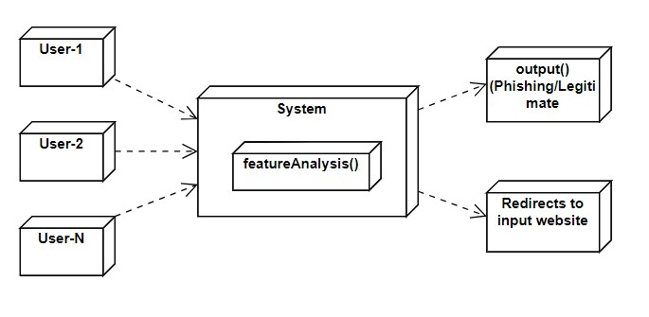
DEPLOYMENT DIAGRAM

Slide 27
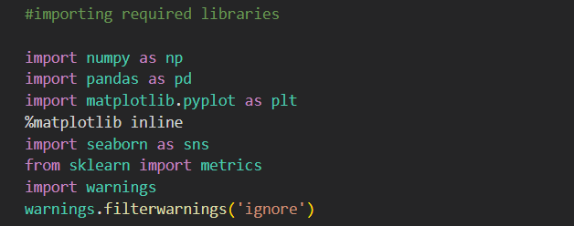
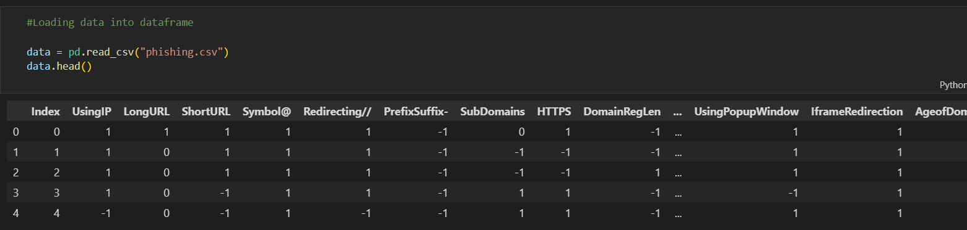
IMPLEMENTATION
IMPORTING LIBRARIES:
LOADING DATA

Slide 28
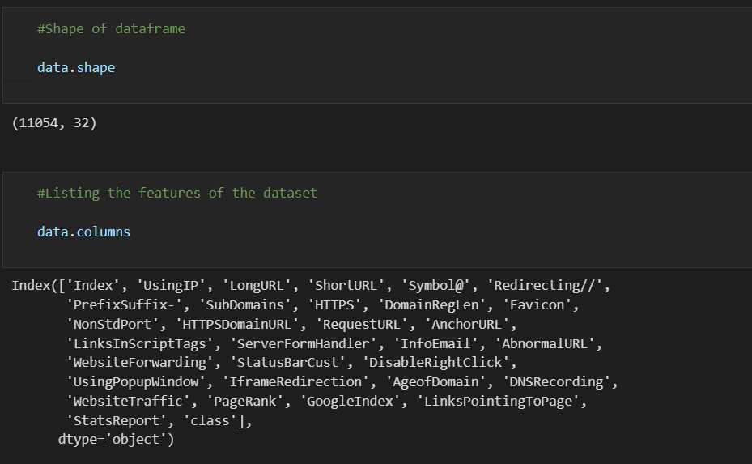
IMPLEMENTATION
FAMILIARISING DATA:

Slide 29
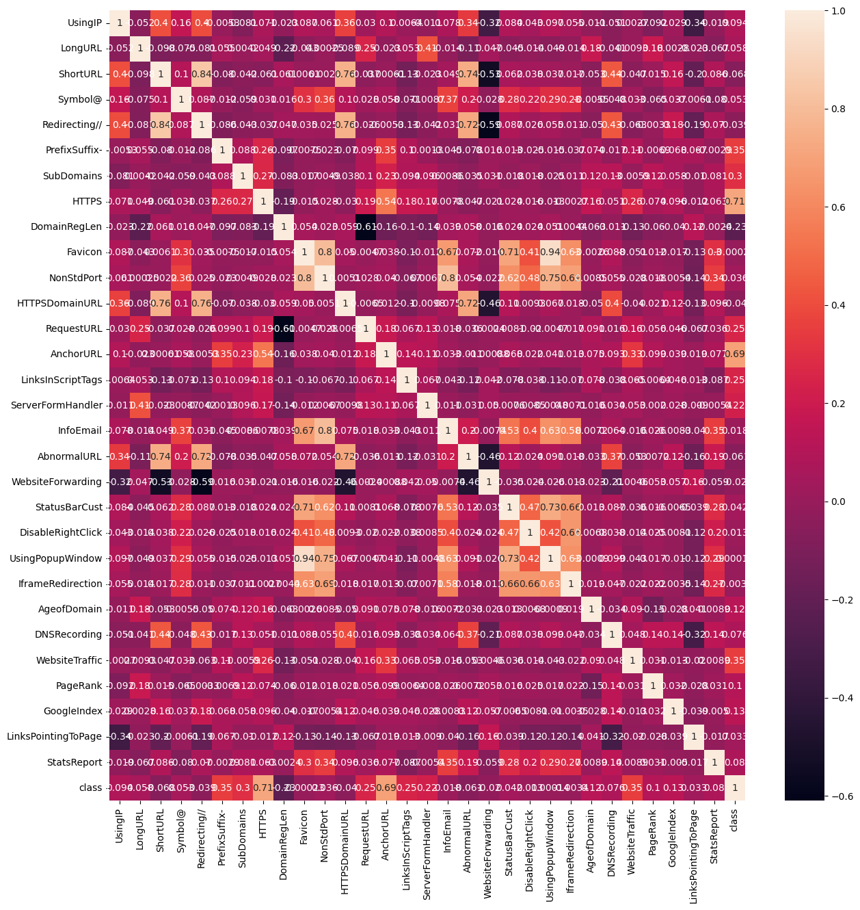
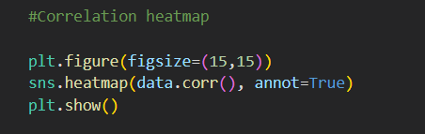
IMPLEMENTATION
VISUALIZING DATA:

Slide 30
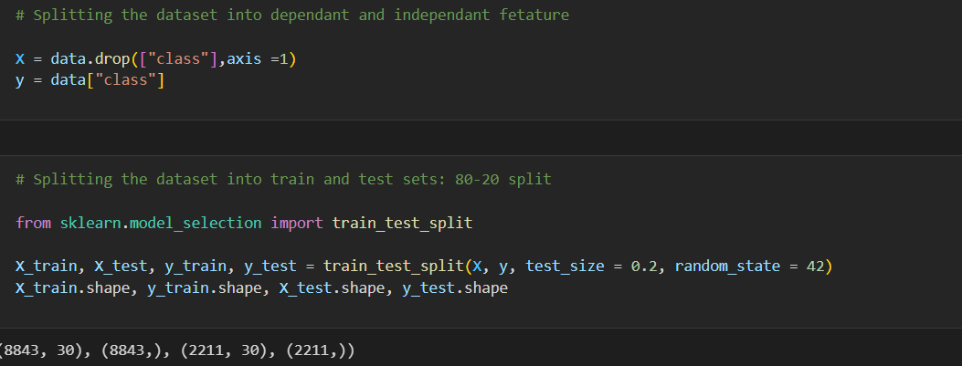
IMPLEMENTATION
SPLITING DATA:

Slide 31
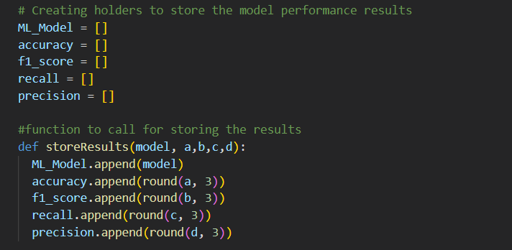
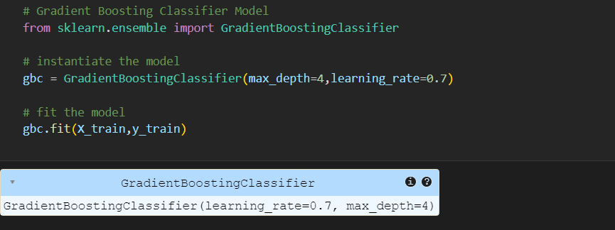
IMPLEMENTATION
MODEL BUILDING:

Slide 32
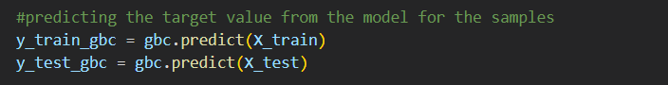
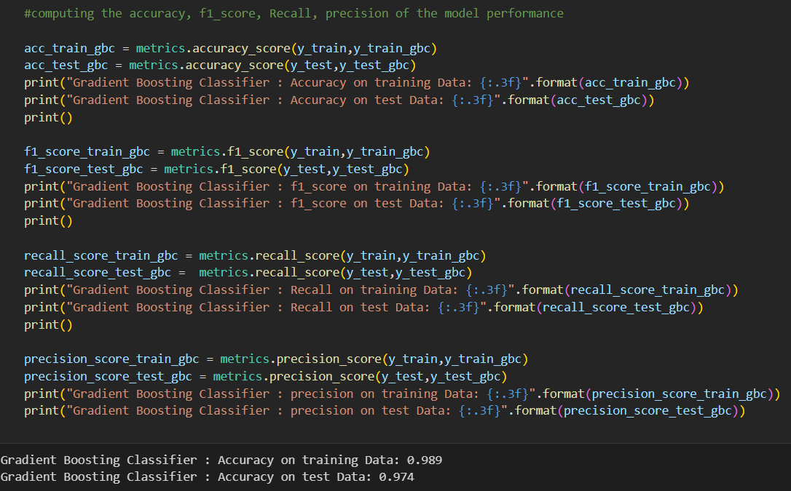
IMPLEMENTATION
MODEL BUILDING:

Slide 33
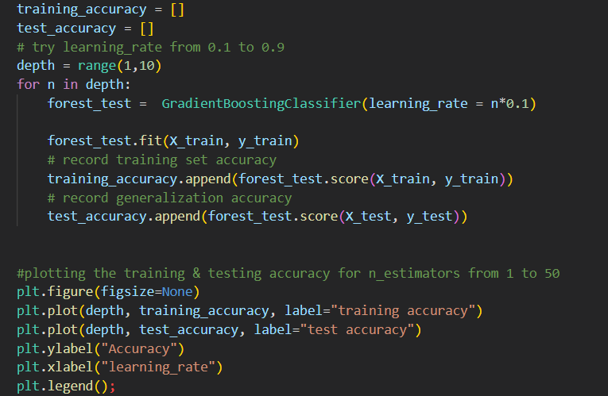
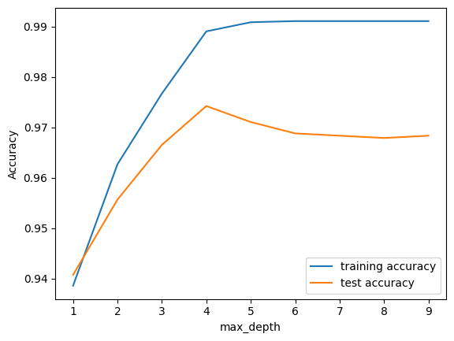
IMPLEMENTATION
PLOTTING ACCURACY

Slide 34
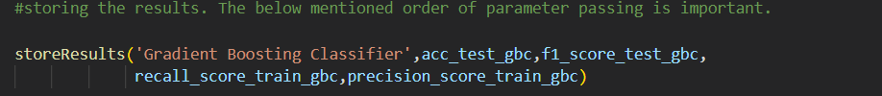
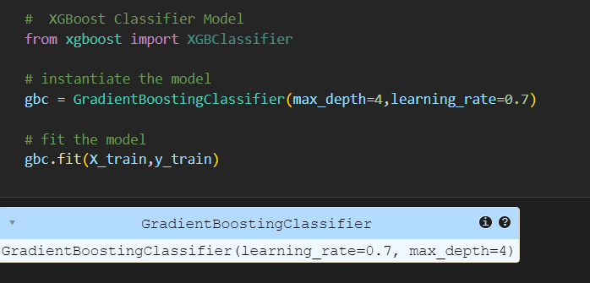
IMPLEMENTATION
STORING THE BEST MODEL

Slide 35
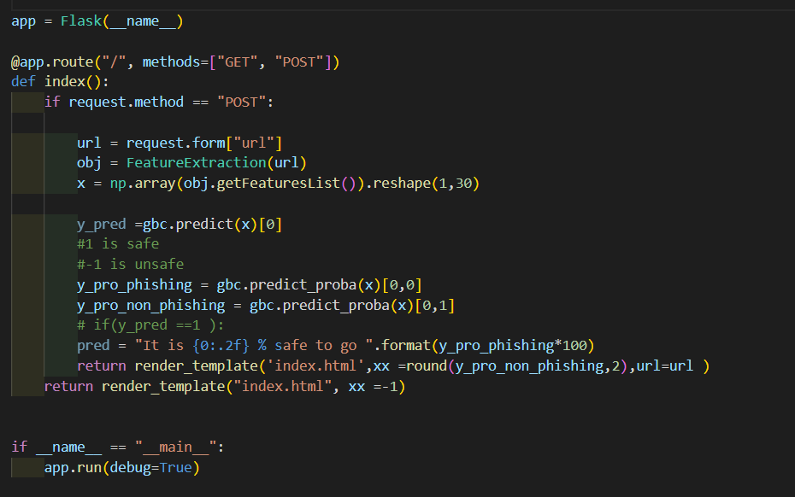
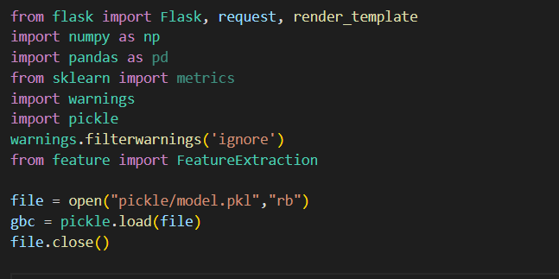
IMPLEMENTATION
FRONTEND

Slide 36
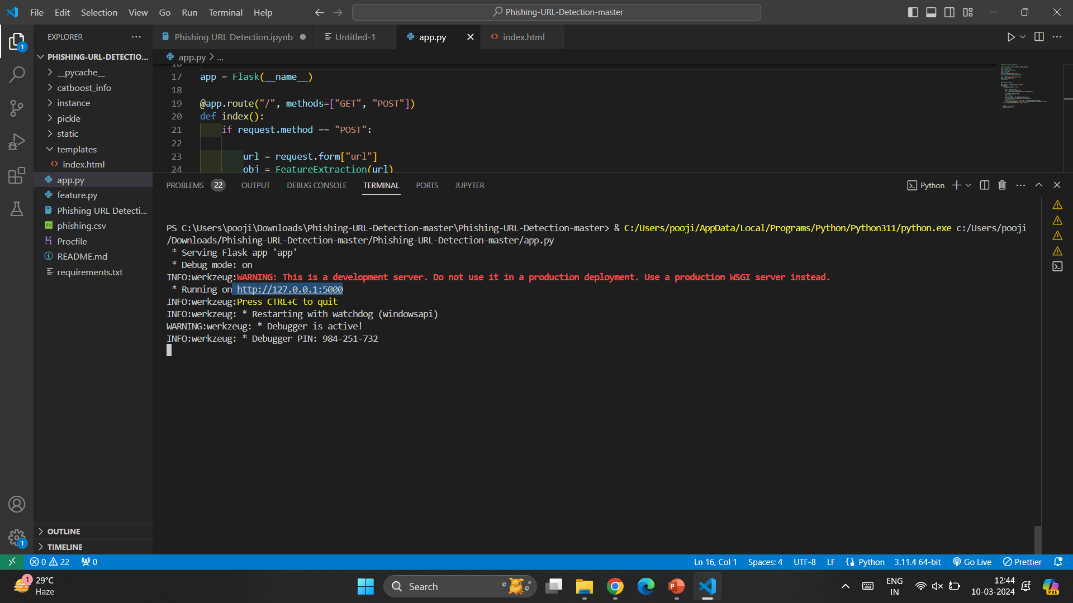
EXECUTION

Slide 37
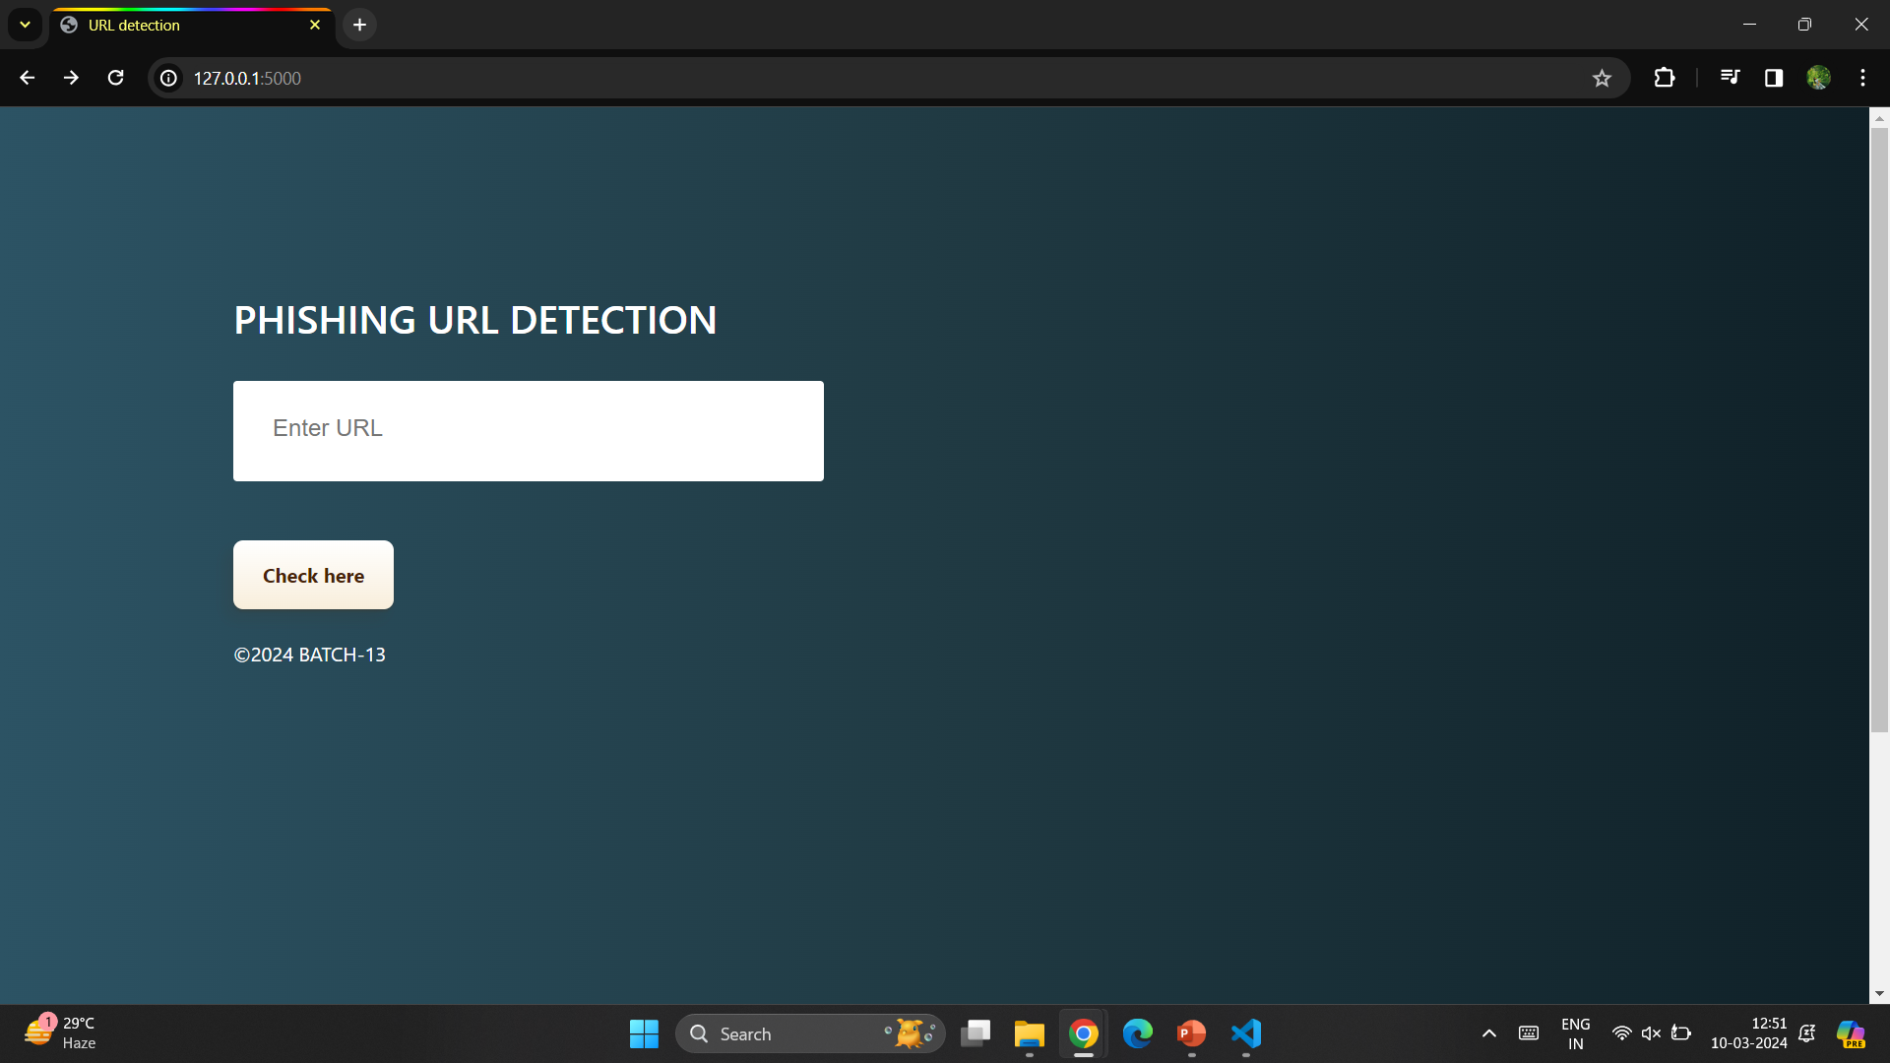
EXECUTION

Slide 38
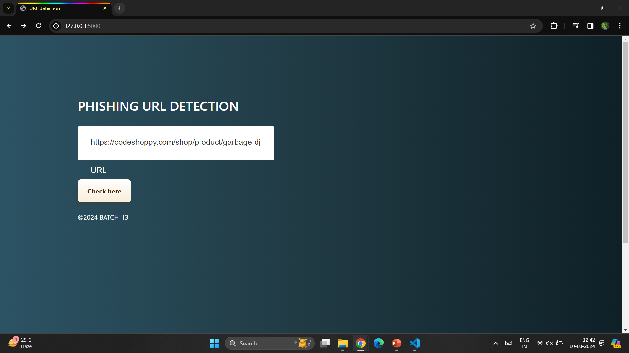
EXECUTION

Slide 39
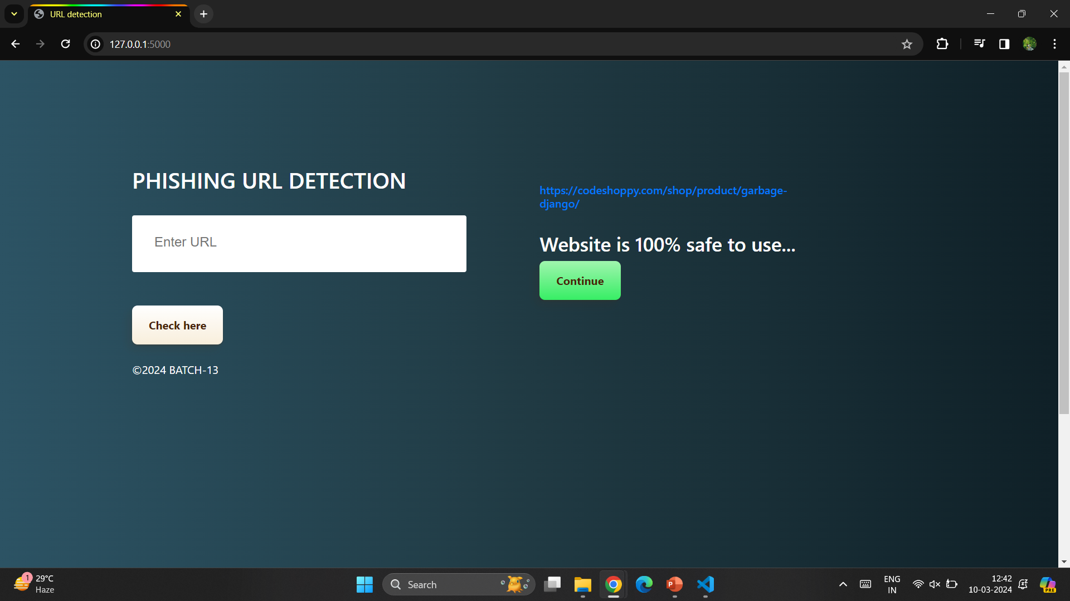
EXECUTION

Slide 40
Thank you

